Slide 1
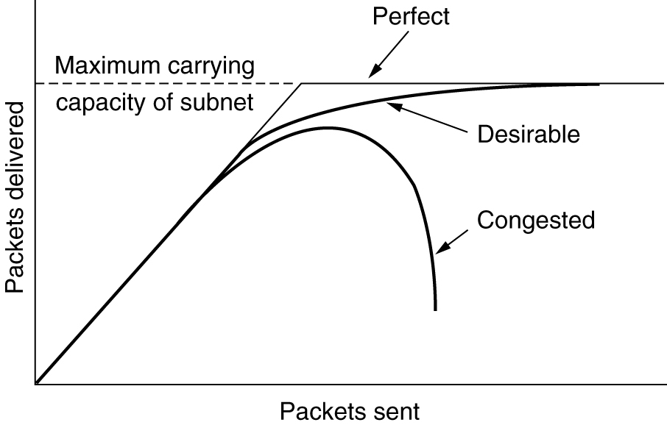
Congestion Control Algorithms
When too many packets are present in the subnet, performance degrades. This situation is called congestion
When too much traffic is offered, congestion sets in and performance degrades sharply.

Slide 2
Congestion Control Algorithms
Congestion can be brought on by several factors:
If all of a sudden, streams of packets begin arriving on three or four input lines and all need the same output line, a queue will build up.
If there is insufficient memory to hold all of them, packets will be lost.
But if routers have an infinite amount of memory, congestion gets worse because by the time packets get to the front of the queue, they have already timed out
Slow processors can also cause congestion.
If the routers' CPUs are slow at performing queuing buffers, updating tables, etc., queues can build up, even though there is excess line capacity.
low-bandwidth lines can also cause congestion.
Upgrading the lines often helps a little

Slide 3
General Principles of Congestion Control
All solutions can be divided into two groups:
open loop
closed loop.
Open loop solutions attempt to solve the problem by good design, to make sure it does not occur in the first place. Once the system is up and running, midcourse corrections are not made.
Closed loop solutions are based on the concept of a feedback loop. This approach has three parts when applied to congestion control.
1) Monitor the system.
- Detect when and where congestion occurs.
2) Pass information to where action can be taken.
3) Adjust system operation to correct the problem.
3

Slide 4
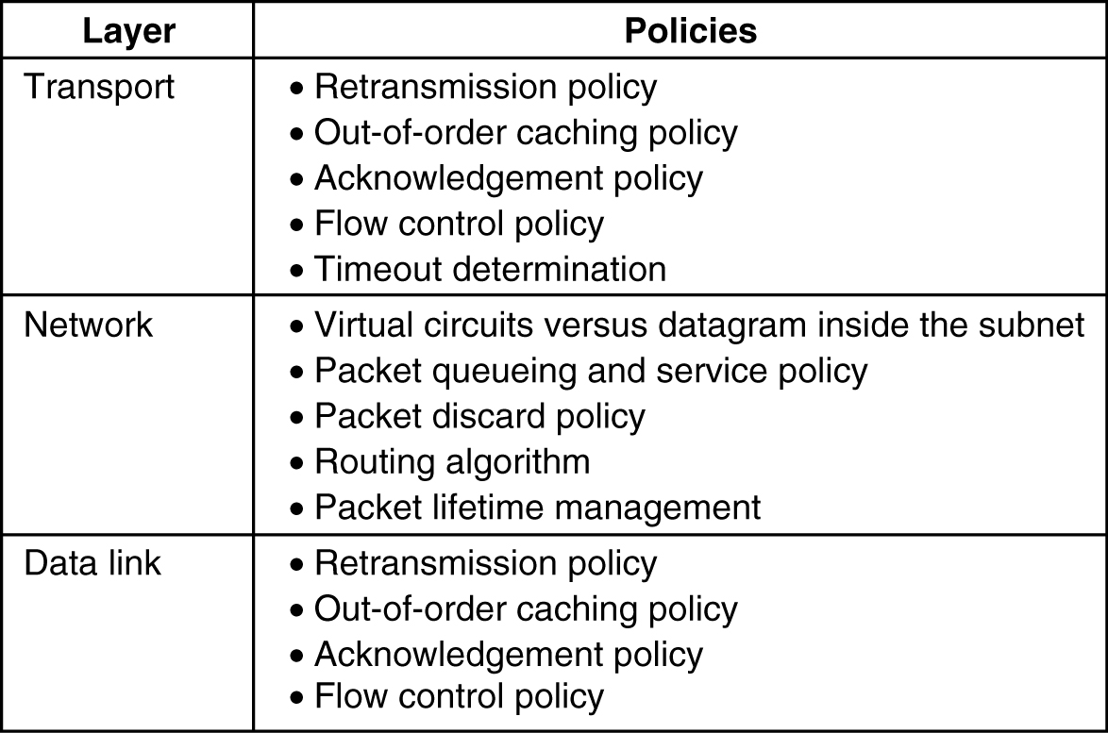
Congestion Prevention Policies
methods to control congestion by looking at open loop systems by using appropriate policies at various levels
5-26
Policies that affect congestion

Slide 5
Congestion Prevention Policies
Policies considered in the Data link layer
Retransmission policy:
how fast a sender times out and what it transmits upon timeout
go back n will put a heavier load on the system than selective repeat
Out-of-order caching policy:
selective repeat is clearly better than go back n
Acknowledgement policy:
Piggybacking onto reverse traffic may help
But extra timeouts and retransmissions may happen.
Flow control Policy:
a small window reduces the data rate and thus helps fight congestion

Slide 6
Congestion Prevention Policies
Policies considered in the Network layer
Choice of virtual circuits vs datagrams:
affects congestion since many congestion control algorithms work only with virtual-circuit subnets
Packet queuing and service policy:
relates to whether routers have one queue per input line, one queue per output line, or both
also relates to the order in which packets are processed (e.g., round robin or priority based)
Packet Discard policy :
rule telling which packet is dropped when there is no space
Routing algorithm:
Good algorithm can help avoid congestion by spreading the traffic over all the lines

Slide 7
Congestion Prevention Policies
Packet lifetime management:
deals with how long a packet may live before being discarded
If it is too long, lost packets may block up the works for a long time
If it is too short, packets may sometimes time out before reaching their destination, thus inducing retransmissions
Policies considered in the Transport layer
Same issues as in data link layer plus
Timeout determination:
determining the timeout interval is harder because the transit time across the network is less predictable
If the timeout interval is too short, extra packets will be sent unnecessarily.
If it is too long, congestion will be reduced but the response time will suffer whenever a packet is lost.

Slide 8
Congestion Control in Virtual-Circuit Subnets
One technique: admission control
Idea is simple:
once congestion has been signaled, no more virtual circuits are set up until the problem has gone away.
Thus, attempts to set up new transport layer connections fail.
Alternative approach:
to allow new virtual circuits
but carefully route all new virtual circuits around problem areas
Figure is shown in the next slide

Slide 9
Congestion Control in Datagram Subnets(Closed loop)
The Warning Bit
Old DECNET architecture & frame relay signaled the warning state by setting a special bit in the packet's header
When the packet arrived at its destination, the transport entity copied the bit into the next acknowledgement sent back to the source
The source then cut back on traffic
As long as the router was in the warning state, it continued to set the warning bit, which meant that the source continued to get acknowledgements with it set.
The source monitored the fraction of acknowledgements with the bit set and adjusted its transmission rate accordingly.
As long as the warning bits continued to flow in, the source continued to decrease its transmission rate.
When they slowed to a trickle, it increases its transmission rate.

Slide 10
Congestion Control in Datagram Subnets
Choke Packets
previous congestion control algorithm uses a roundabout means to tell the source to slow down. Why not just tell it directly?
In this approach, the router sends a choke packet back to the source host, giving it the destination found in the packet.
original packet is tagged (a header bit is turned on) so that it will not generate any more choke packets farther along the path and is then forwarded in the usual way.
When the source host gets the choke packet, it is required to reduce the traffic sent to the specified destination by X percent.

Slide 11
Congestion Control in Datagram Subnets
Since other packets aimed at the same destination are probably already under way and will generate yet more choke packets,
the host should ignore choke packets referring to that destination for a fixed time interval.
After that period has expired, the host listens for more choke packets for another interval.
If one arrives, the line is still congested, so the host reduces the flow still more and begins ignoring choke packets again.
If no choke packets arrive during the listening period, the host may increase the flow again.

Slide 12
Congestion Control in Datagram Subnets
Hop-by-Hop Choke Packets
At high speeds or over long distances, sending a choke packet to the source hosts does not work well because the reaction is so slow.
Refer to figure (a) of next slide
Alternative approach is to have the choke packet take effect at every hop it passes through
Refer to figure a of next slide
as soon as the choke packet reaches F, F is required to reduce the flow to D.
Doing so will require F to devote more buffers to the flow, since the source is still sending away at full blast
This is done till the choke packet reaches the source
net effect is to provide quick relief at the point of congestion at the price of using up more buffers upstream

Slide 13
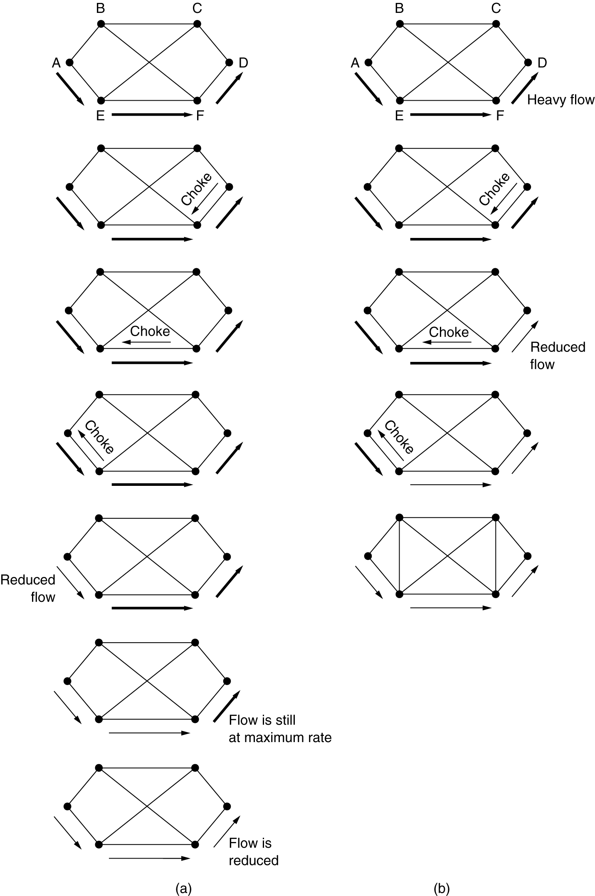
Hop-by-Hop Choke Packets
(a) A choke packet that affects only the source.
(b) A choke packet that affects each hop it passes through.

Slide 14
4.Load Shedding
Load shedding is a fancy way of saying that when routers are being flooded by packets that they cannot handle, they just throw them away
Methods for dropping:
can just pick packets at random to drop
discard may depend on the applications running
For file transfer, an old packet is worth more than a new one
old is better than new is often called wine
For multimedia, a new packet is more important than an old one.
new is better than old is often called milk
To implement an intelligent discard policy, applications must mark their packets in priority classes to indicate how important they are.

Slide 15
Load Shedding
senders might be allowed to send high-priority packets under conditions of light load
but as the load increased they would be discarded, thus encouraging the users to stop sending them
Another option is to allow hosts to exceed the limits specified in the agreement negotiated when the virtual circuit was set up (e.g., use a higher bandwidth than allowed)
but subject to the condition that all excess traffic be marked as low priority.

Slide 16
5.Random Early Detection
dealing with congestion after it is first detected is more effective than letting it gum up the works and then trying to deal with it.
idea is to discarding packets before all the buffer space is really exhausted
To determine when to start discarding, routers maintain a running average of their queue lengths.
When the average queue length on some line exceeds a threshold, the line is said to be congested and action is taken.

Slide 17
6.Jitter Control
For applications such as audio and video streaming, it does not matter much if the packets take 20 msec or 30 msec to be delivered, as long as the transit time is constant.
The variation (i.e., standard deviation) in the packet arrival times is called jitter.
High jitter, for example, having some packets taking 20 msec and others taking 30 msec to arrive will give an uneven quality to the sound or movie.

Slide 18
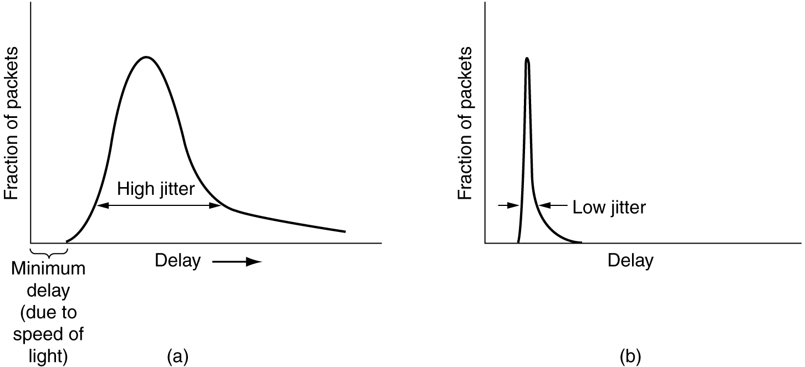
Jitter Control
(a) High jitter. (b) Low jitter.

Slide 19
Jitter Control
The jitter can be controlled by computing the expected transit time for each hop along the path.
When a packet arrives at a router, the router checks to see how much the packet is behind or ahead of its schedule.
This information is stored in the packet and updated at each hop.
If the packet is ahead of schedule, it is held just long enough to get it back on schedule.
If it is behind schedule, the router tries to send it out quickly.
both cases reducing the amount of jitter
In applications such as video on demand, jitter can be eliminated by buffering at the receiver and then fetching data for display from the buffer instead of from the network in real time.
In real time applications like Internet telephony & videoconferencing, the delay inherent in buffering is not acceptable.

